Slide 1
MHW1
Marco Pararore
O46002248
Data

Slide 2
Descrizione del progetto
Si Tratta di una pagina Home di un negozio On-Line di musica
Ci sarà quindi la possibilità di comprare musica con il proprio profilo e quindi fare registrazione e login
Inoltre ci sarà possibilità di visualizzare info su chi lavora al negozio, la sua posizione e gestione

Slide 3
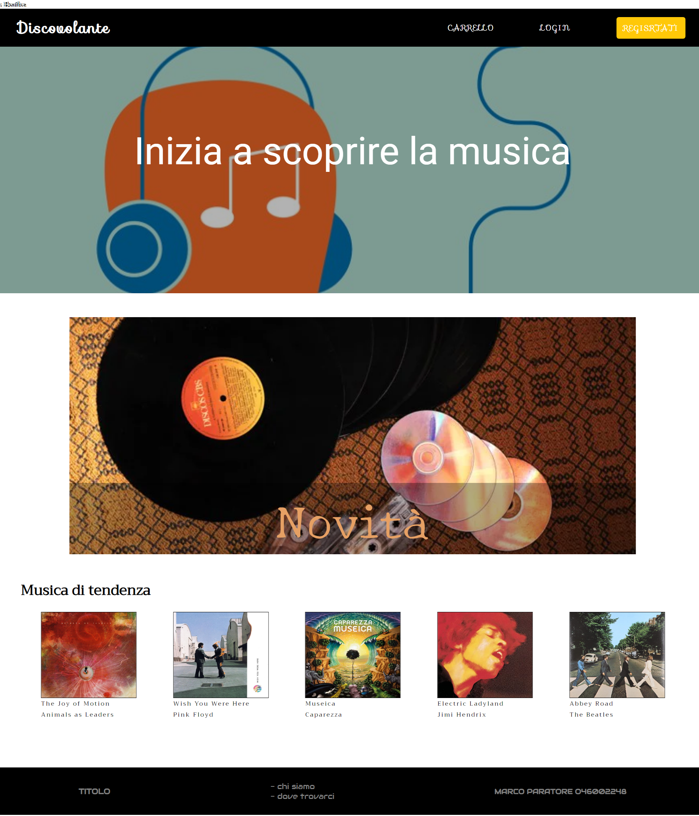
Layout complessivo HTML+CSS

Slide 4

Header
<header>
<div class = overlay> </div>
<nav>
<div id = 'titolo'>
<strong> Discovolante </strong>
</div>
<div id = 'link'>
<a> CARRELLO </a>
<a> LOGIN </a>
<a class = 'button'> REGISRTATI </a>
</div>
<div id = menu>
<div> </div>
<div> </div>
<div> </div>
</div>
</nav>
<div class = 'mainFrase'>
<a> Inizia a scoprire la musica </a>
</div>
</header>

Slide 5
CSS Header
header {
height: 600px;
font-family: 'Roboto', verdana;
background-image: url(https://static.billboard.com/files/media/music-listening-illustration-2019-billboard-1548-768x433.jpg);
background-size: cover;
position: relative;
display: flex;
flex-direction: column;
align-items: center;
justify-content: center;
}
.overlay {
position: absolute;
top: 0;
left: 0;
bottom: 0;
right: 0;
background-color: rgba(0, 0, 0, 0.3);
}
header .mainFrase {
text-align: center;
line-height: 70px;
font-size: 80px;
z-index: 1;
}
.mainFrase a:hover {
color: rgb(220, 220, 220);
}
header nav,
section a {
letter-spacing: 2px;
}
nav {
height: 80px;
font-family: 'Sofia', sans;
display: flex;
align-items: center;
justify-content: space-between;
position: absolute;
top: 0;
left: 0;
right: 0;
background-color: black;
}
nav #titolo {
font-size: 2rem;
margin: 40px;
}
nav #link a {
margin: 0px 3vw;
}
a.button {
background-color: rgb(255, 200, 8, 1);
padding: 10px 14px;
border-radius: 5px;
}
a.button:hover {
background-color: rgb(255, 200, 8, 0.9);
}

Slide 6

Menù navigazione
nav {
height: 80px;
font-family: 'Sofia', sans;
display: flex;
align-items: center;
justify-content: space-between;
position: absolute;
top: 0;
left: 0;
right: 0;
background-color: black;
}
nav #link a {
margin: 0px 3vw;
}
a.button {
background-color: rgb(255, 200, 8, 1);
padding: 10px 14px;
border-radius: 5px;
}
a.button:hover {
background-color: rgb(255, 200, 8, 0.9);
}
<div id = 'link'>
<a> CARRELLO </a>
<a> LOGIN </a>
<a class = 'button'> REGISRTATI </a>
</div>

Slide 7

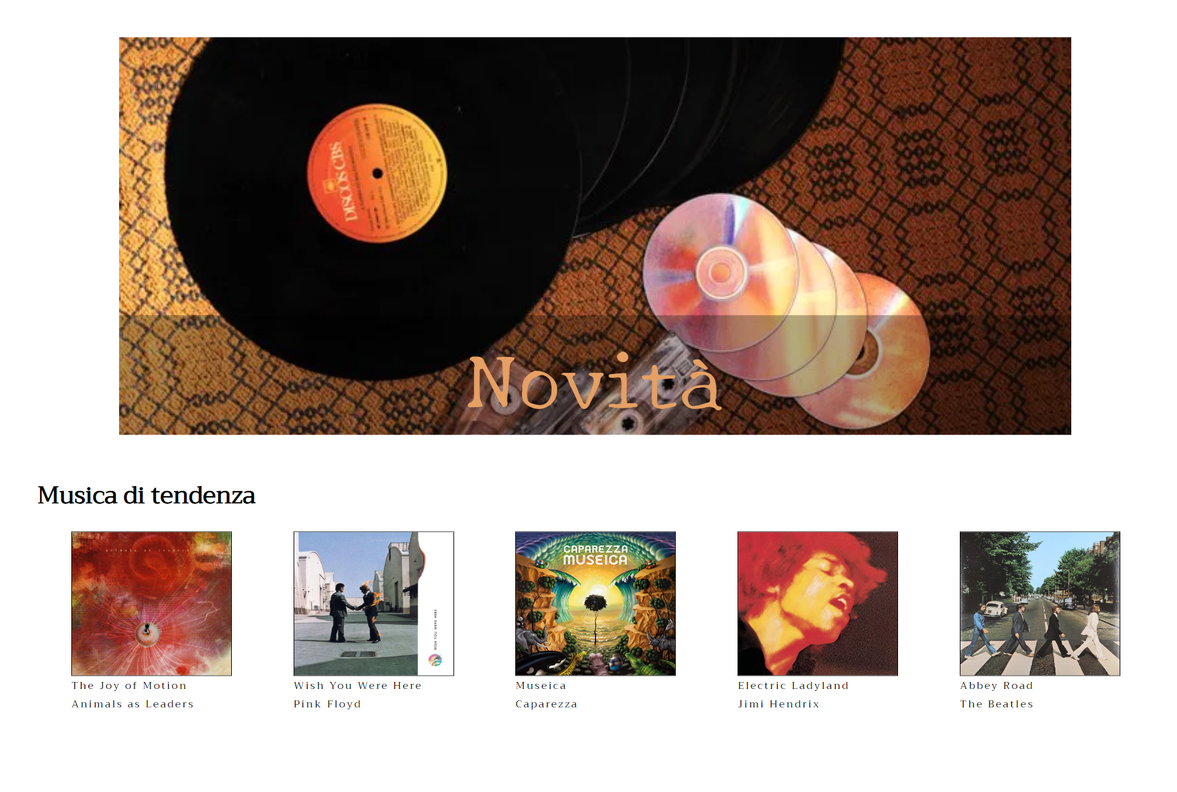
Sezione contenuti

Slide 8
<section>
<div id = 'up'>
<a> Novità </a>
<div class = 'overlay'>
</div>
</div>
<div id = 'down'>
<h1> Musica di tendenza </h1>
<div id = 'albums'>
<div>
<img src = https://images-na.ssl-images-amazon.com/images/I/91TDajE5oHL._AC_SL1500_.jpg />
<a> The Joy of Motion </br> Animals as Leaders </a>
</div>
<div>
<img src = https://images-na.ssl-images-amazon.com/images/I/71m0ofUWYXL._AC_SL1300_.jpg />
<a> Wish You Were Here </br> Pink Floyd </a>
</div>
<div>
<img src = https://m.media-amazon.com/images/I/81yLvpHlURL._SS500_.jpg />
<a> Museica </br> Caparezza </a>
</div>
<div>
<img src = https://images-na.ssl-images-amazon.com/images/I/81BY1RNu7oL._AC_SX355_.jpg />
<a> Electric Ladyland </br> Jimi Hendrix </a>
</div>
<div>
<img src = https://images-na.ssl-images-amazon.com/images/I/91YlTtiGi0L._AC_SL1500_.jpg />
<a> Abbey Road </br> The Beatles </a>
</div>
</div>
</div>
</section>
HTML Section

Slide 9
CSS Section
#up a {
font-family: 'New Tegomin', serif;
color: rgb(230, 160, 100);
position: absolute;
position: absolute;
top: 70%;
left: 0;
right: 0;
bottom: 0;
font-size: 100px;
z-index: 1;
} section #down {
color: black;
font-family: 'Trirong', Arial;
font-size: 13px;
margin-bottom: 100px;
}
#down h1 {
margin: 0px 47px;
font-size: 30px;
} #albums{
display: flex;
justify-content: space-around;
padding: 0px 50px;
margin-top: 20px;
} #albums img {
width: 100%;
height: 100%;
border: .5px solid black;
} #albums div {
height: 180px;
width: 200px;
}
section {
height: 1000px;
display: flex;
flex-direction: column;
}
section #up {
margin: 50px 10vw;
height: 500px;
background-image: url(https://dday.imgix.net/system/uploads/news/main_image/34307/vinyl-records-discs.jpg?w=702&h=360&fit=crop&auto=format%2Ccompress&s=66de7028c4e3de1df8a167a495910fcf);
background-size: cover;
position: relative;
text-align: center;
}
#up .overlay {
background-color: rgba(0, 0, 0, 0.3);
position: absolute;
top: 70%;
left: 0;
right: 0;
bottom: 0;
}

Slide 10
Footer
<footer>
<div>
<strong> TITOLO </strong>
</div>
<div class = 'info'>
<a> - chi siamo </a> </br>
<a> - dove trovarci</a>
</div>
<div>
<h1>MARCO PARATORE O46002248</h1>
</div>
</footer>
footer {
font-family: 'Audiowide', helvetica;
color: gray;
height: 100px;
background-color: black;
display: flex;
justify-content: space-around;
align-items: center;
}
footer h1{
font-size: 15px;
}

